Slide 1
techbuddies
Cathy Dao
Kyah Fukunaga
Erin Dwyer

Slide 3
Need
Erin
Will
Kyah
Solution
Cathy

Slide 4
Need
Erin

Slide 6
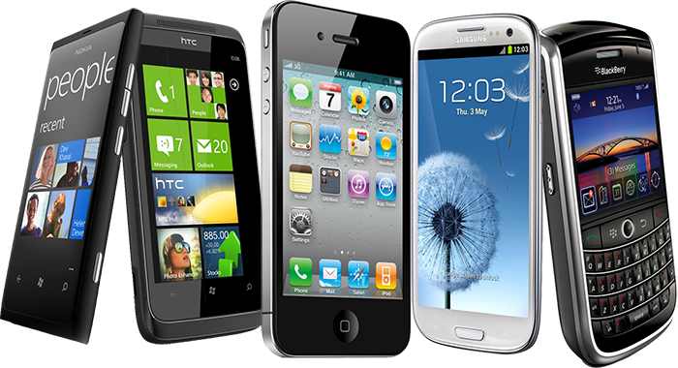
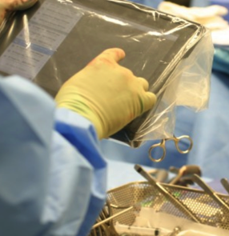
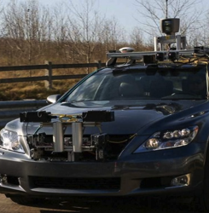
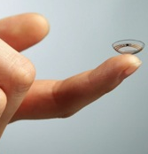
Technology affects every field:
Notes:
The reality is that technology affects every field of commerce
In healthcare – computing is part of operating rooms every day and it is enabling breakthroughs like these contact lenses that detect levels of insulin for people with diabetes
In space – we are depending on a generation of robots to explore where humans cannot now
In our homes -- we are automating everyday things like our heating systems
On our roads – we depend on navigation systems to get us home and now we are experimenting with bringing self-driving cars into our everyday lives
In entertainment – blockbuster movies depend on computer science to bring new characters to life and provide us new completely animated worlds
And every single day this trend is growing across every single industry

Slide 7
Will
Kyah

Slide 8
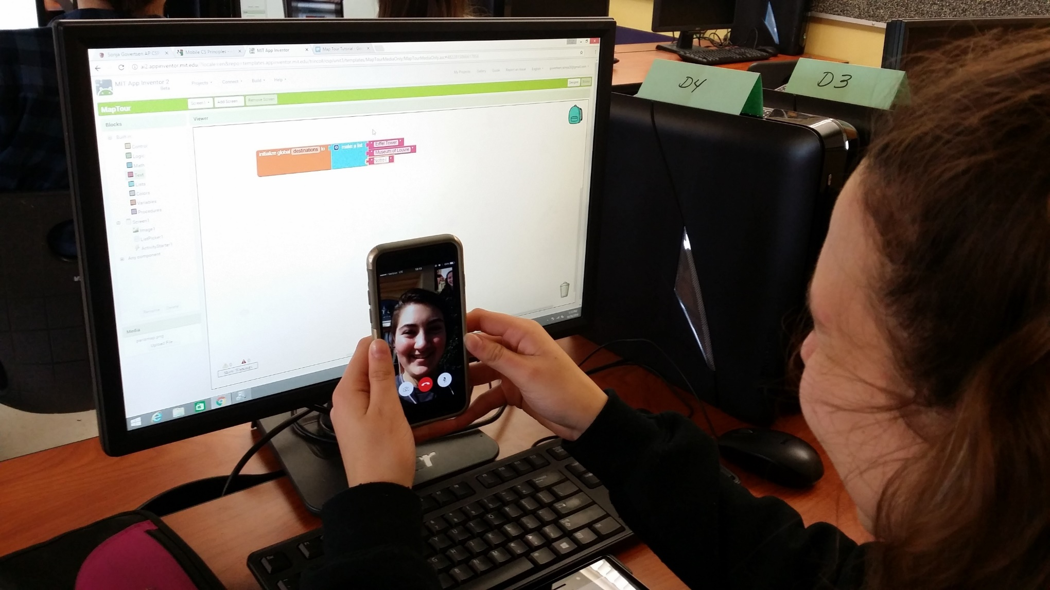

Slide 10
Solution
Cathy

Slide 11
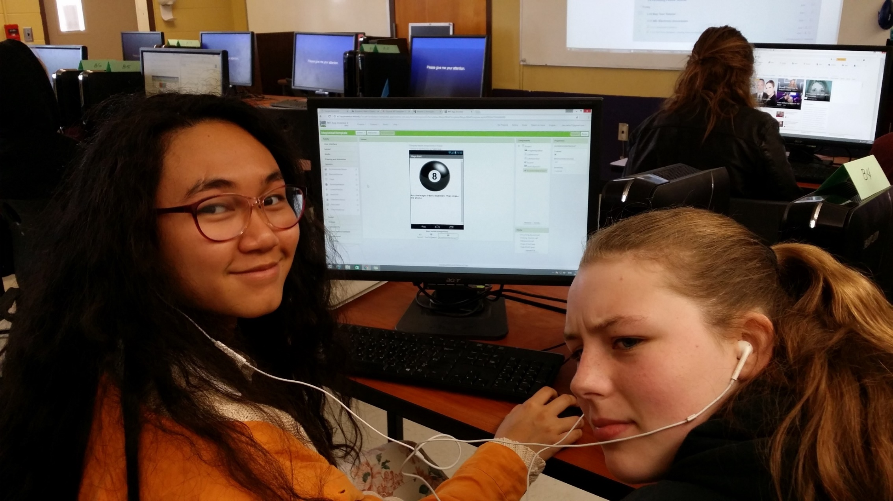

Slide 13
techbuddies
Cathy Dao
Kyah Fukunaga
Erin Dwyer

Slide 14
Collaboration
Teaching & Learning
Career & Technical Education

Slide 16
